Slide 1





Impact Oriented Research
Professor Mike Smith
Emeritus Professor of Medical Science
Managing Partner, Harper Keeley LLP
Chair, Medipex Ltd
Integrating societal impact in a research strategy
28 November – 30 November 2018, Leuven

Slide 2
Research, Innovation & Commercialisation
First 20 years:
Medical scientist working on new medical technology, working in University Hospital Medical Schools, the NHS and with industry
Published extensively and raised large amounts of grant funding and investment
Partnership working internationally and with commercial companies
Research and developed ideas and solutions that were available for patient benefit and of commercial interest

Slide 3
Research, Innovation and Commercialisation
Recent 20 years:
Continued impact oriented research plus licensing, start-ups, spin-outs & commercialisation opportunities
Extended personal commercial innovation activity into a wider range of technologies and businesses
Corporate role as Pro Vice Chancellor in Universities and Director in the NHS, developing policy
Non-Executive Director in a range of commercial ventures
Chair and Founder of Medipex Ltd, a company to commercialise IP emerging from the health sector
Chair of the Institute of Knowledge Transfer
Formed an investment fund for Medical Technology

Slide 4
Societal Impact
More
Stronger economy
New companies
Exports
Jobs
Stronger society
Better Health
Better Education
Independence in old age
Less
Inequalities
Poverty
Sickness and disease
Unemployment
Social care burden
Crime/violence/terrorism
Pollution
Climate change

Slide 5
Personal perspective of impact (1)
Impact had been used in research for many years, since the 1970s - terms like ‘impact factor’ were embedded in the vocabulary of research
In my own research I wanted to improve the health of patients (help them get better quicker or stop them becoming ill) – in the 1970s to 1990s I wasn’t aware that I was focussing on impact
As an assessor for the UK research assessment exercises in 1996 and 2001, and a University lead for submissions, I experienced the then strategy, and problems, of focusing on research outcome, as it was called then, rather than impact

Slide 6
Personal perspective of impact (2)
From the early 2000s the word impact increased in usage – and over-usage
Narratives and indicators associated with the impact on Economic Transformation particularly in relation to regional/national/European structural funding
Narratives but fewer indicators around Social Transformation, often presented to counter or complement the emphasis on economic impact
Increase use of the term in driving wider funding decisions, only in some cases with an increased understanding and acceptance of the difference between impact and evaluation

Slide 7
Personal perspective of impact (3)
Tendency to concentrate on ‘impression management’ to convince people of impact, particularly the reliance on good news stories
Funded organisations and individuals comply with or object to the measurement of impact – but rarely considered changing what they do or how they do it, to increase impact
Generally little awareness that funding bodies might be wanting to use the measurement of impact as a lever for change and to support their policy agendas

Slide 8
ACTIVITY
Outcome
Evaluation
IMPACT
Output
NO
Separate analytical processes with quality constraints

Slide 9
Impact Dichotomies
Research | or | Education
High quality research | or | Any innovative activity
Economic impact | or | Social impact
Short term impact | or | Long term impact
Quantitative indicators | or | Qualitative indicators
Unbiased assessment | or | Marketing information
Rigorous | or | Impression focused
Objective | or | Subjective (opinion lead)
Defensive | or | Transparent
Funded | or | Unfunded

Slide 11
What is the challenge that needs to be resolved?
How could this challenge be resolved?
Is there new or emerging understanding, science, methodology or technology which indicates than now is the time ?
Who else is interested; are they partners or competitors?
What would success look like ? Essentially what parameters would you measure to demonstrate success (and show the impact)?
If you identify a solution, do you need to undertake further work to ensure it is implemented and becomes widely adopted, to achieve maximum impact ?
What is the end point and exit strategy?

Slide 12
Clarification of CHALLENGE
Development
Product production
Implementation
Research
Adoption of SOLUTION
Contextual understanding

Slide 13
Clarification of CHALLENGE
Development
Product production
Implementation
RESEARCH
Adoption of SOLUTION
Contextual understanding

Slide 14
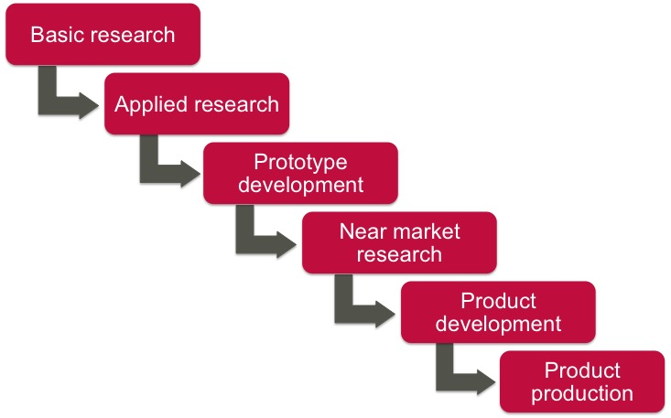
Clarification of CHALLENGE
Development
Product production
Implementation
Research
Adoption of SOLUTION
Contextual understanding
see next slide

Slide 15
Basic research
Prototype development
Near market research
Product development
Applied research
Product production

Slide 16
Valley of Death
$€£
Basic research | Applied research | Prototype development | Near market research | Product development | Product production

Slide 17
Sector Specific Impact Parameters – Health
High Level – Examples
Epidemiologically adjusted Mortality Rates
QUALYs (Quality Adjusted Life Years)
Human Development Parameters (IQ etc)
Clinical Effectiveness (this has a specific definition in medicine and health)
Economic Cost Effectiveness
Change in national policy
All supported by high quality evidence

Slide 18
Sector Specific Impact Parameters – Health
Intermediate Level – Examples
Clinical Efficacy (this has a specific definition in medicine and health)
Measurable change in clinical practice (and its magnitude)
Survival rates
Patient response and reaction (eg reduced discomfort/stress)
Cost reduction
Change in local/regional policy
All should be quantifiable and verifiable

Slide 19
Sector Specific Impact Parameters – Health
Preliminary Level – Examples
Potential clinical efficacy
Potential change in clinical practice
Preliminary changes in survival rates
Preliminary patient response and reaction
Predicted cost reduction
Change in departmental/institutional policy
These measures of ‘impact’ are unlikely to be rigorously quantifiable or verifiable

Slide 20
Case Study 1:
Research, Development and Implementation
Non-invasive bone mineral measurement and the development of bone scanners for osteoporosis

Slide 21
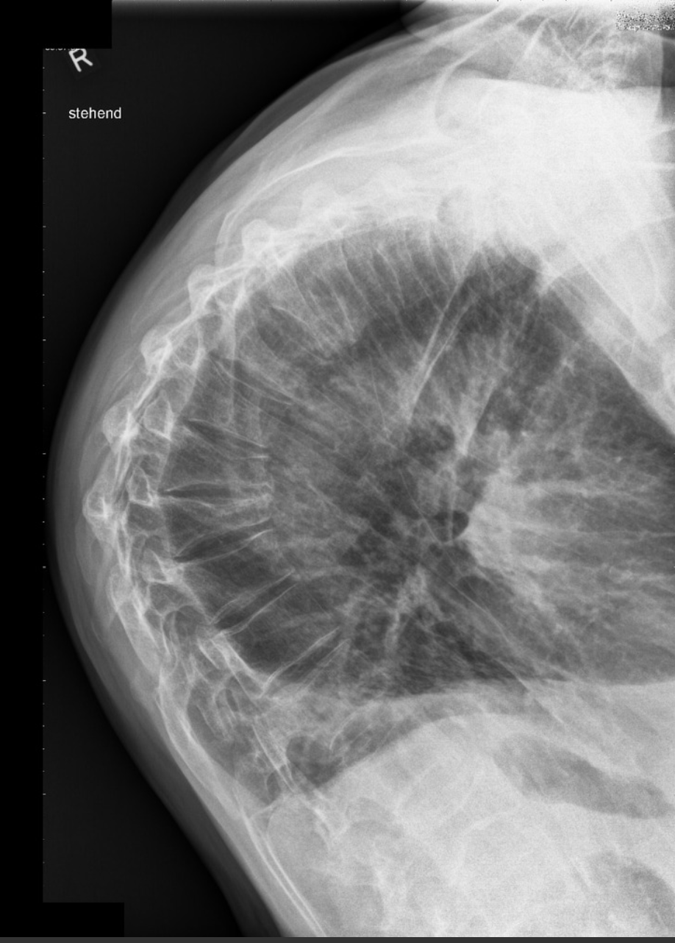
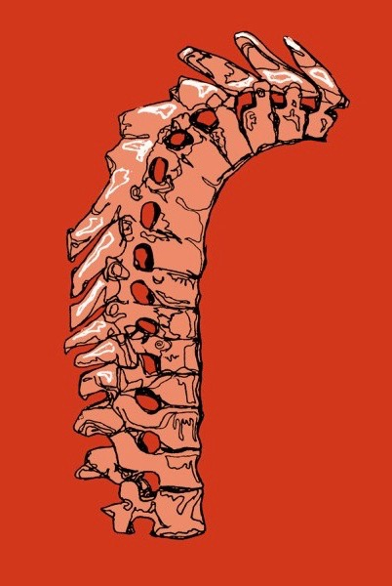
Dowager’s hump

Slide 22
Osteoporosis - Incidence and burden
Osteoporosis affects ~75 million people in Europe, USA & Japan.
Worldwide, 1 in 3 women over age 50 will experience osteoporotic fractures, as will 1 in 5 men aged over 50.
In Europe, disability due to osteoporosis is greater than most cancers and is comparable or greater than rheumatoid arthritis, asthma and high blood pressure related heart disease.
In women over 45 years of age, osteoporosis accounts for more days spent in hospital than many other diseases, including diabetes, myocardial infarction and breast cancer.
A 10% loss of bone mass in the vertebrae can double the risk of vertebral fractures, and similarly, a 10% loss of bone mass in the hip can result in a 2.5 times greater risk of hip fracture .
Notes:
Osteoporosis is estimated to affect 200 million women worldwide - approximately one-tenth of women aged 60, one-fifth of women aged 70, two-fifths of women aged 80 and two-thirds of women aged 90.
Osteoporosis takes a huge personal and economic toll.
UK: In 2010 approximately 536,000 new fragility fractures each year; number of people aged 50+ with osteoporosis, approximately 3.21 million; economic burden of new and prior fractures £ 3,496 (€ 5,408) million each year; by 2025 burden will increase by 24 % to £ 5,465 (€ 6,723) million (254).

Slide 23
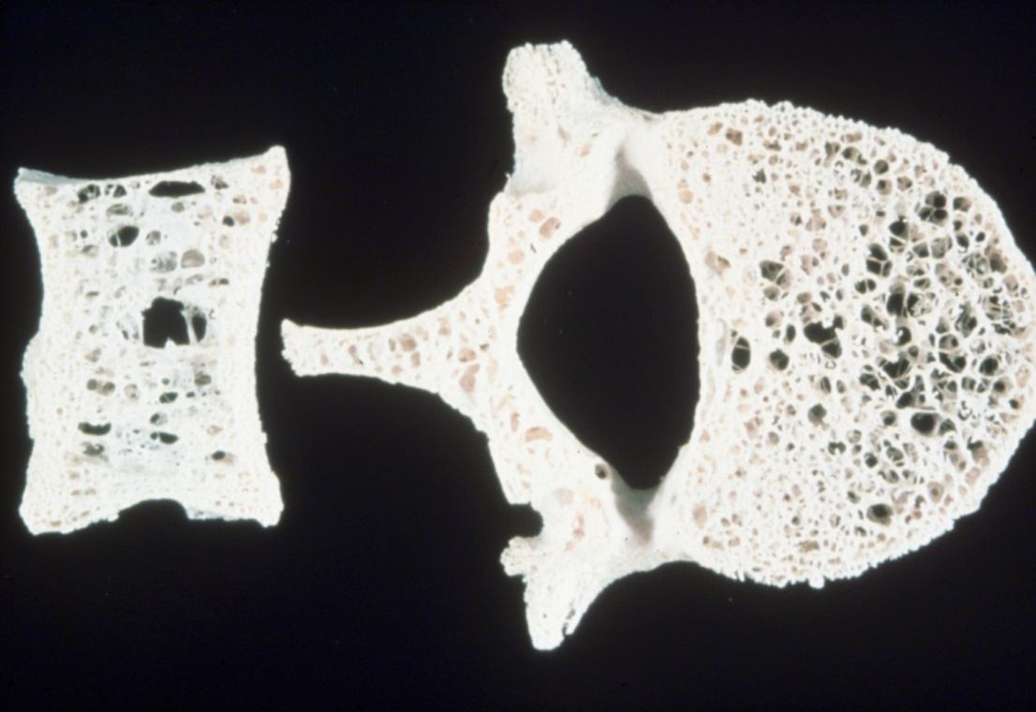


Slide 24
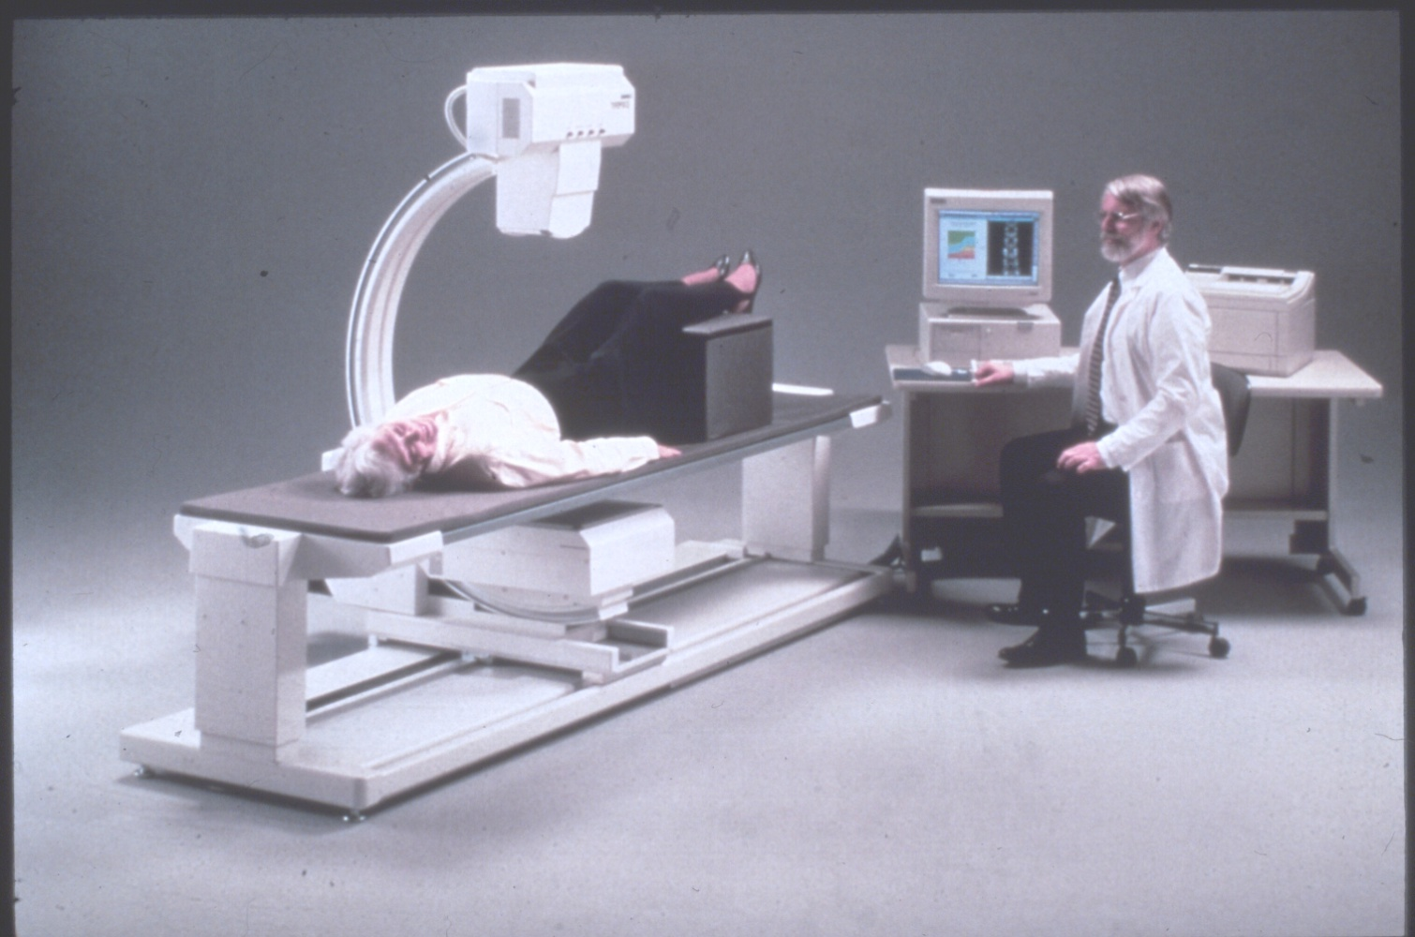

Slide 25
Bone Scanners for Osteoporosis (UK)
  First research abstract published
  Development of equipment
  Commercial equipment available
  Purchased by research groups
  Initial purchase by NHS
  Questions about cost effectiveness
  Advocacy campaign
  Widespread NHS use
  Impact on societal health
1963
1974 - 1980
1978 - 1982
1978 - 1988
~1990
1994
1995 - 1998
2000
?

Slide 26
Clarification of CHALLENGE
Development
Product production
Implementation
Research
Adoption of SOLUTION
Contextual understanding

Slide 27
Case Study 2:
Research through to Commercialisation
Magnetic Resonance Imaging

Slide 28
Computerised Tomography (CT)
Tomo~ From the Greek meaning ‘a slice’
~graphy adapted from the English/American and meaning:
‘a machine for a hospital costing a load of money which will make its manufacturers a fortune’

Slide 29
Computerised Tomography (CT)
Developed by EMI in the early 1970s, systems were quickly installed many hospitals. Changed the attitude towards ‘scanners’.
Legislation introduced in the USA to restrict their use.
Back-projection mathematics (1917)
Semiconductors (1960s)
Mini-computers (1970s)

Slide 30
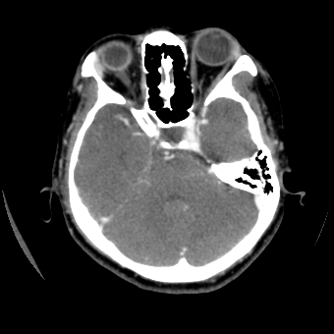

Slide 31
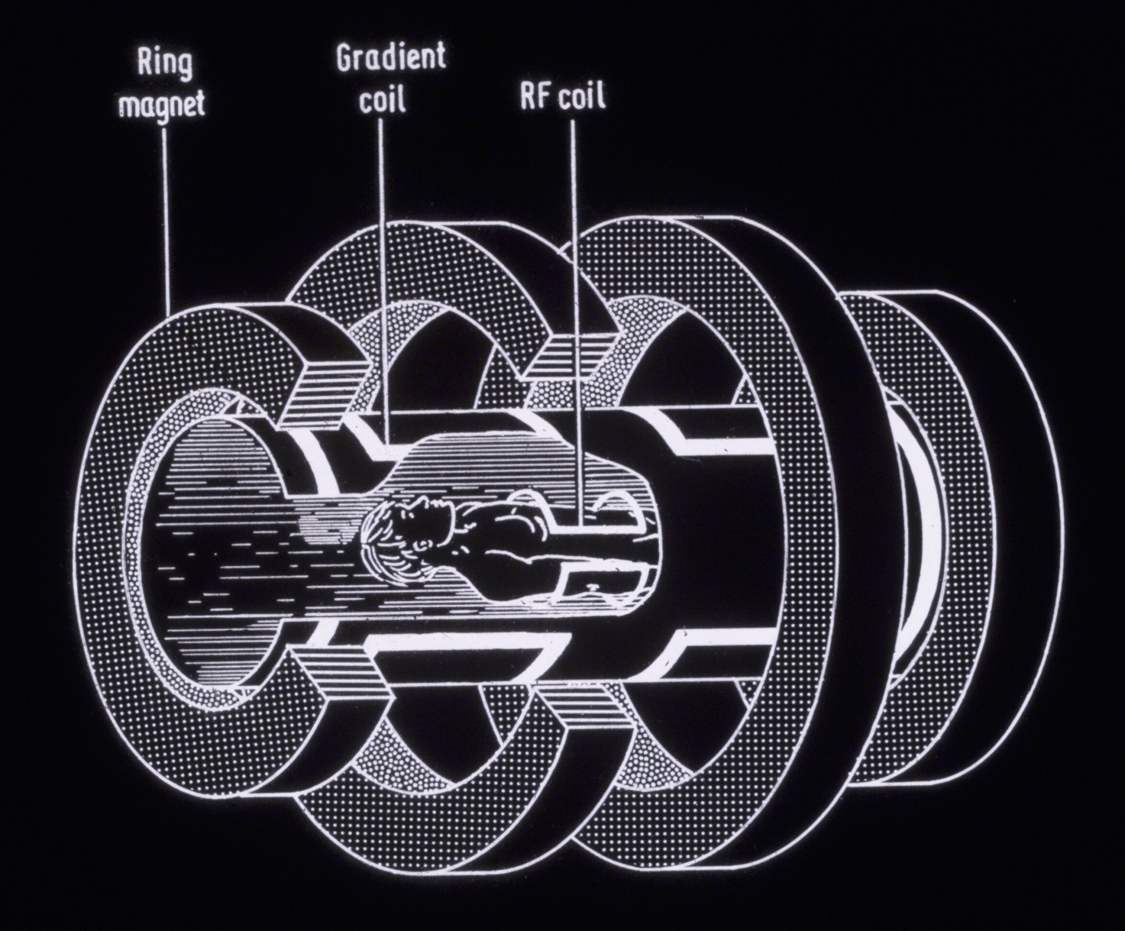
Magnetic Resonance Imaging
Magnets
RRF Coil

Slide 32
Development of X-ray CT and MRI
1985
1980
Commercial availability
1975
1970
Initial idea
X-ray CT
MRI

Slide 33
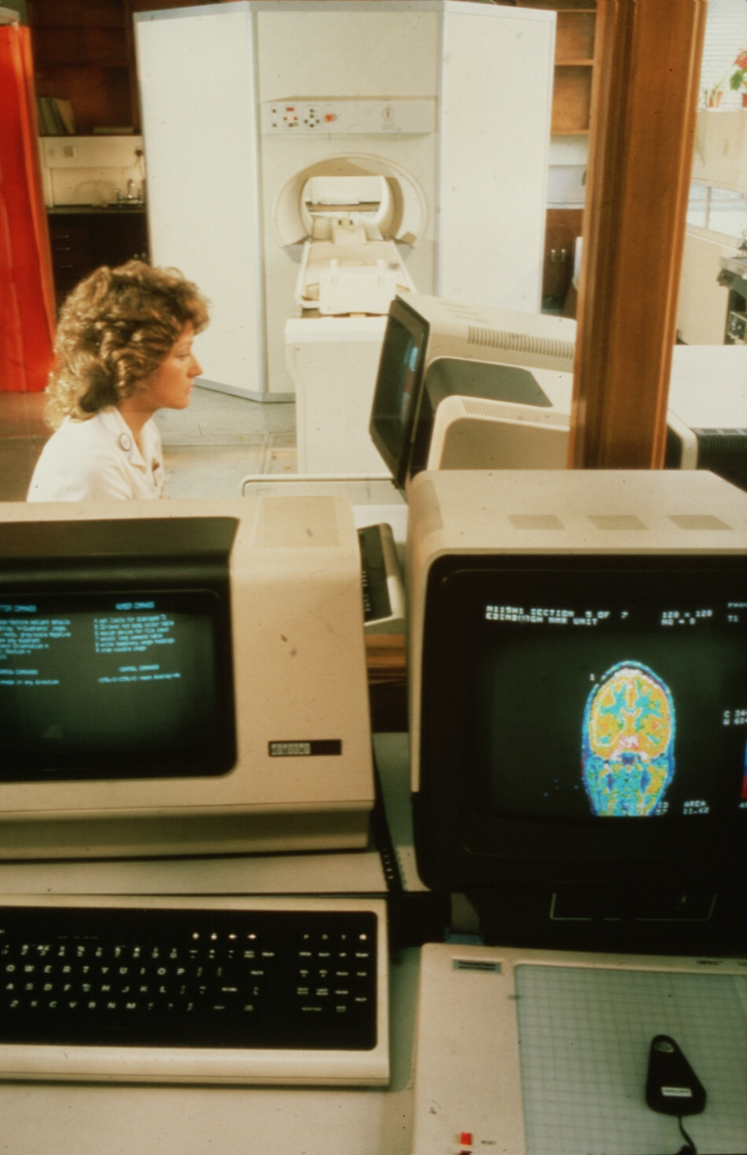
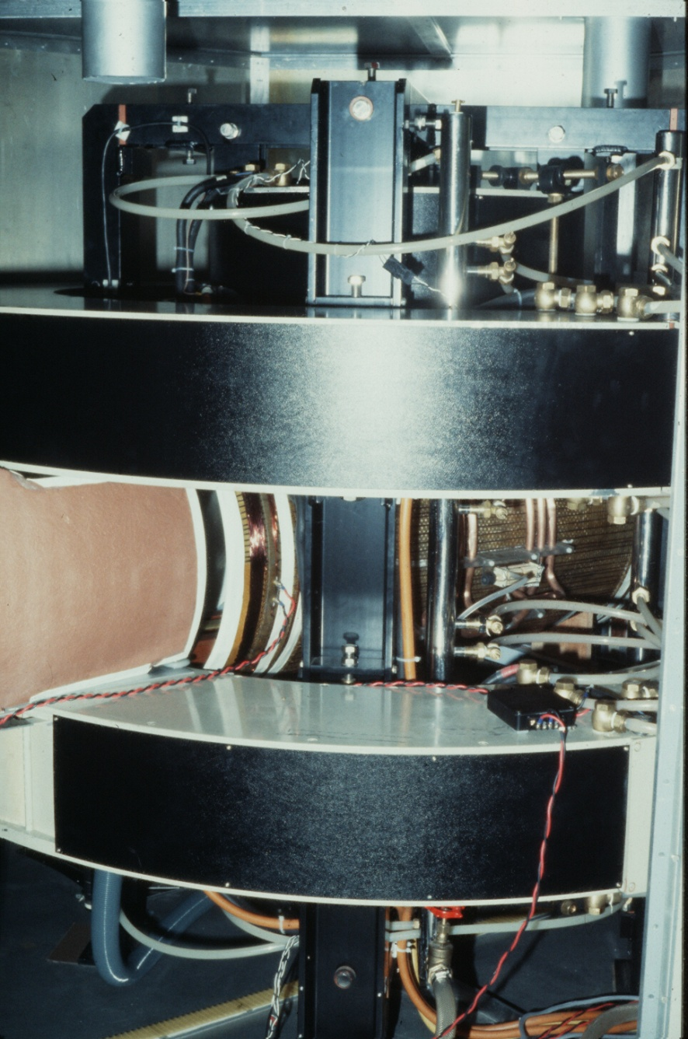

Slide 34
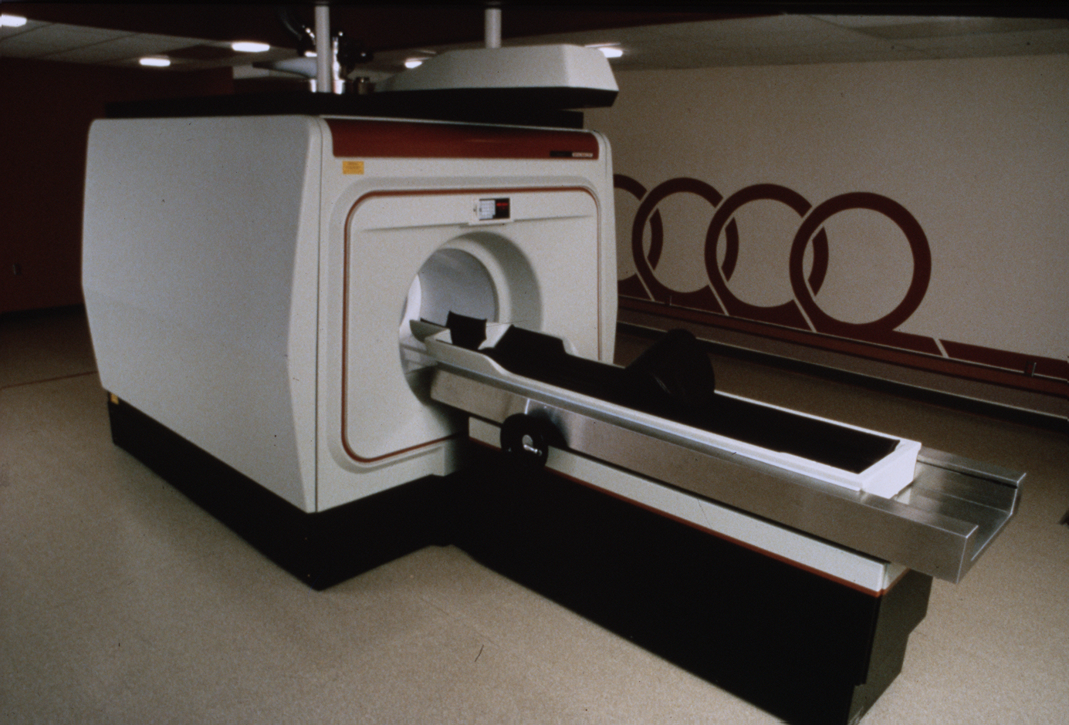

Slide 35
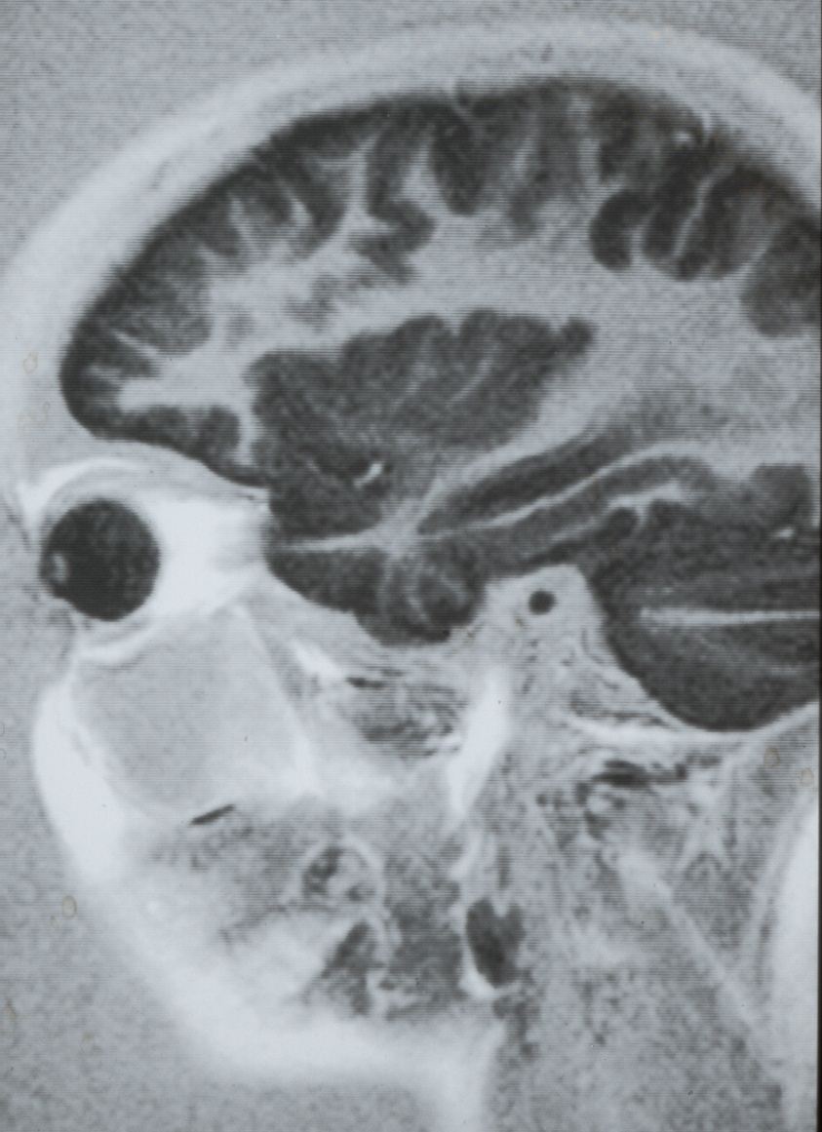
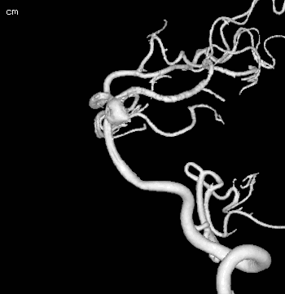

Slide 36
Magnetic Resonance Imaging (1)
Following the impact and financial success of CT, the science/engineering of MRI was funded and developed
Paper which underpinned the practical approach to clinical MRI
Development of low field commercial system from UK company (University spin-out)
Development of low field commercial systems from global imaging companies
Forced sale of UK company
1974 – 1982
1980
1982 - 1985
1983 > 1989
1986

Slide 37
Magnetic Resonance Imaging (2)
Development of high field MRI systems by global imaging companies
Wide availability in health systems with an ‘impact’ on health care and patient management
Clinical and cost effectiveness (ie everyday use in non-selected patients) started to become clearer
Which impact is important?
Commercial impact
Health system impact
Individual patient impact
Economic impact
Societal impact
1987 > 2010
1995 >
2005 >

Slide 38
Clarification of CHALLENGE
Development
Product production
Implementation
Research
Adoption of SOLUTION
Contextual understanding

Slide 39
Case Study 3:
Contextual understanding, implementation and adoption
Kangaroo Care

Slide 40
This slide contains confidential images which will be shown during the presentation but which, for reasons of copyright, cannot be digitally reproduced for circulation.

Slide 41
Babies and families in neonatal units
~10% of babies admitted to neonatal units; about 70,000 annually in UK
Numbers and length of stay increased almost threefold since mid-1990s
This is due to improved survival at lower gestation, increased multiple births, increased maternal age

Slide 42
This slide contains confidential images which will be shown during the presentation but which, for reasons of copyright, cannot be digitally reproduced for circulation.

Slide 43
This slide contains confidential images which will be shown during the presentation but which, for reasons of copyright, cannot be digitally reproduced for circulation.

Slide 44
This slide contains confidential images which will be shown during the presentation but which, for reasons of copyright, cannot be digitally reproduced for circulation.

Slide 45

Kangaroo/skin-to-skin care
Significant improvements in the following
Breastfeeding
Head circumference growth
Oxygen saturation
Hypothermia
Serious morbidity at two and six months
With no adverse effects

Slide 46
This slide contains confidential images which will be shown during the presentation but which, for reasons of copyright, cannot be digitally reproduced for circulation.

Slide 47
Health research and impact
This is much wider than medical research
Not only can it have a significant impact on population health it can have a greater impact per unit cost than medical research
A health dividend produces an economic dividend
Can produce conflict with technological/commercially focussed interventions which could have a commercial/economic impact

Slide 48
Clarification of CHALLENGE
Implementation
Research about implementation
Adoption of SOLUTION
Contextual understanding

Slide 49
Case Study 4:
Long-Term Strategic Research
Thin film nanoscience - High Power Impulse Magnetron Spluttering (HIPIMS) Research Group

Slide 50
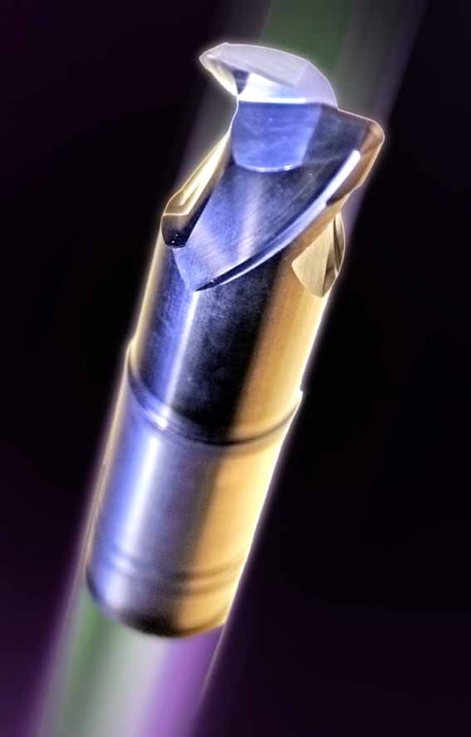


Slide 51
Engineering Research
500,000 researchers
Materials Research
100,000 researchers
Thin Film Research
10,000 researchers
Plasma Vapour Deposition (PVD)
3,000 researchers
High Power Impulse Magnetron Spluttering (HIPIMS)
200 researchers

Slide 52
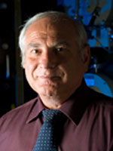
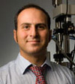
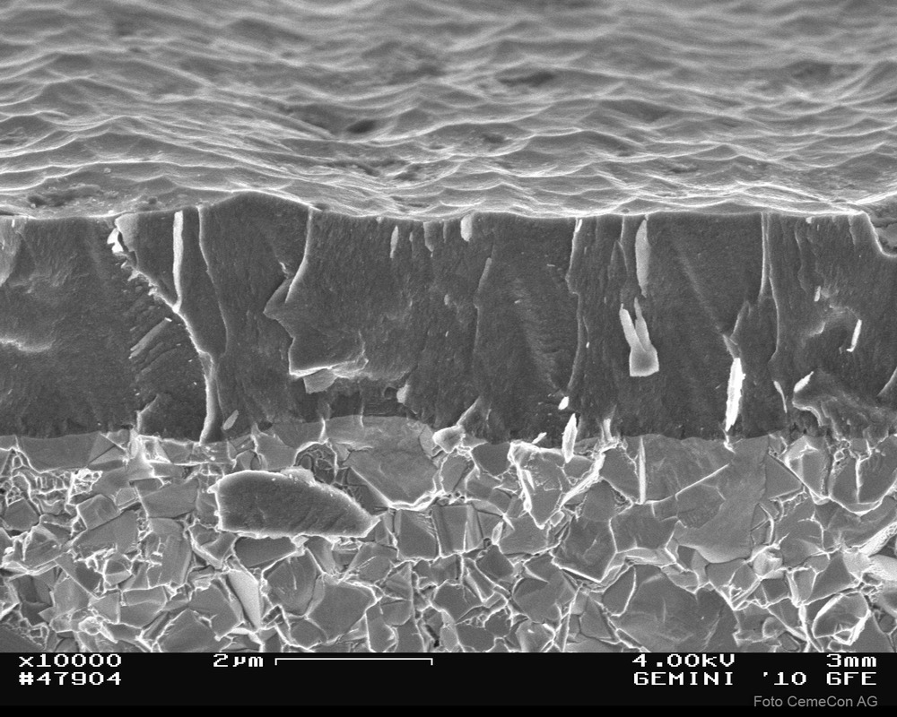
High Power Impulse Magnetron Spluttering (HIPIMS)
Sheffield Hallam University
Prof Papken Hovsepian
Prof Arutiun ‘Harry’ Ehiasarian
Thin film deposition with structural integrity

Slide 53
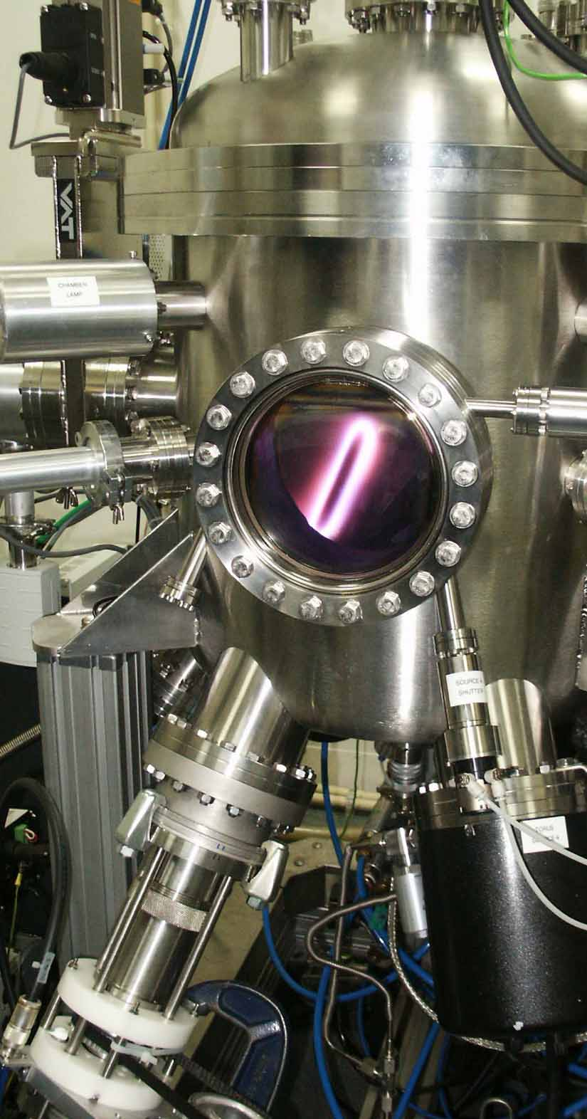

High Power Impulse Magnetron Sputtering Research Group
First joint UK/Fraunhofer Centre
Partnerships with major German and UK global companies
Extensive patent portfolio

Slide 54
HIPIMS Research Group – 20 years old
University investment in the best equipment and infrastructure
Prestigious international quality publications and significant patent portfolio
The group has raised major funding from EU, Government and Industry
International leaders in the science and technology of HIPIMS and run the Global Conference on HIPIMS
First joint UK / Fraunhofer Research Centre
Major international industrial partners

Slide 55
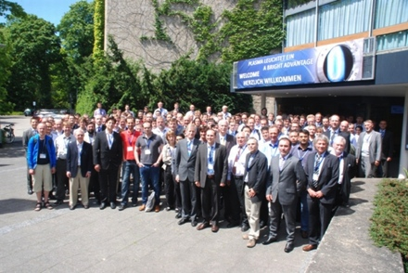
Sixth International Conference on Fundamentals and Industrial Applications of HIPIMS – June 2015
Every two years, alternating between Sheffield & Braunschweig
Significant industrial and academic interest and contribution

Slide 56
Case Study 5:
Contextual understanding and implementation
Contract from an SME to review a manufacturing process in order to improve business efficiency

Slide 57
Business School identified ways to streamline the company’s processes
Materials Engineering identified way to improve the manufacturing process
Consequences:
Positive response from company and good PR for University ✓
Income to the University and justification for government funds ✓
Improved cost-effectiveness for the company ✓
Staff redundancies so negative job creation ✗
Company did not re-invest savings to grow company ✗
Overall economic and societal impact – more ✗ than ✓

Slide 58
Case Study 6:
Stimulating Impact
Special Purpose Vehicle to identify and commercialise IP emerging from the Health Sector

Slide 59


Slide 60
University/Hospital
Professional Services
Medipex
Good innovations
Dubious innovations
Bad innovations
Forgotten innovations
Lost innovations
Hidden innovations
Unoriginal innovations
Parochial innovations
Enthusiasm
Compliance
Control
Indifference
Antagonism
Patent agents
IP Lawyers
Investors
Registration of Designs and Trademarks
Licence Agreements
Accountants
Corporate lawyers
Preliminary assessment of innovations
Finding innovations
Liaison with staff and organisation
Specialist brokerage
De-risk

Slide 61

Model for Partnership
‘Company Limited by Guarantee’
Not for profit
All Hospitals can be members (equivalent to shareholders) with additional, external non-executive directors
Universities are partners
Private sector governance
Can manage state aid issues
Can operate a trading subsidiary
Can interface effectively with specialist professionals (IP lawyers, patent agents, funding agencies etc)

Slide 62
Principal Medipex activities
Knowledge transfer in the healthcare sector with the NHS and at the NHS/University interface
IP awareness raising, education and training
Sector specific identification and management of IP
Patent registration and IP protection
Assessment of commercial potential
Commercial exploitation - license, spin-out or start-up formation
Non-commercial exploitation of IP
Commercialisation of the knowledge base in the NHS/University
An effective business model to drive impact

Slide 63
Concluding Remarks

Slide 64
Distorting impact
Increase in ‘impression management’ by institutions
PR and marketing require ‘good’ news stories as opposed to stories about strong impact
Proof by example of good impact rather than a comprehensive overall assessment of impact
Reticence about using rigorous quantitative indicators
Focus on ‘academic impact’
Profile on academic social media sites
Commercial internet sites set up to ‘increase impact’
‘Cyber loafing’

Slide 65
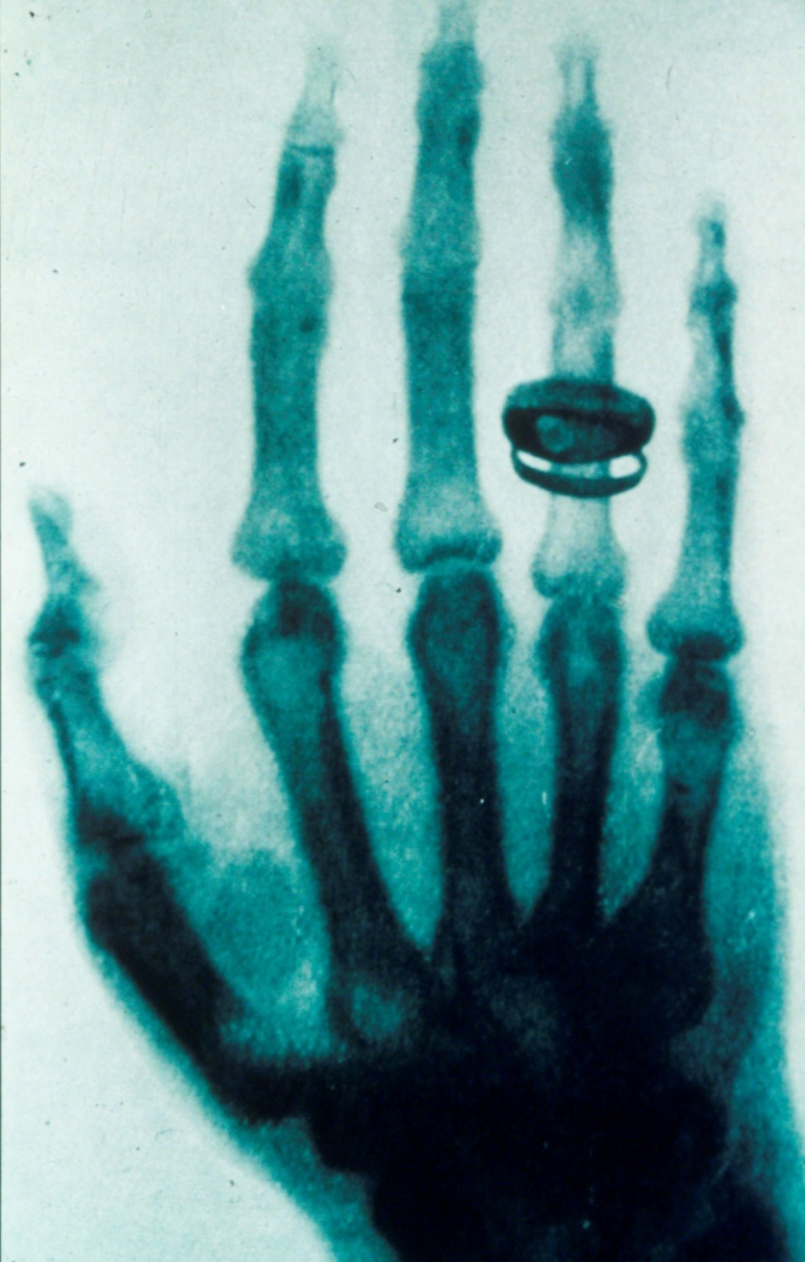
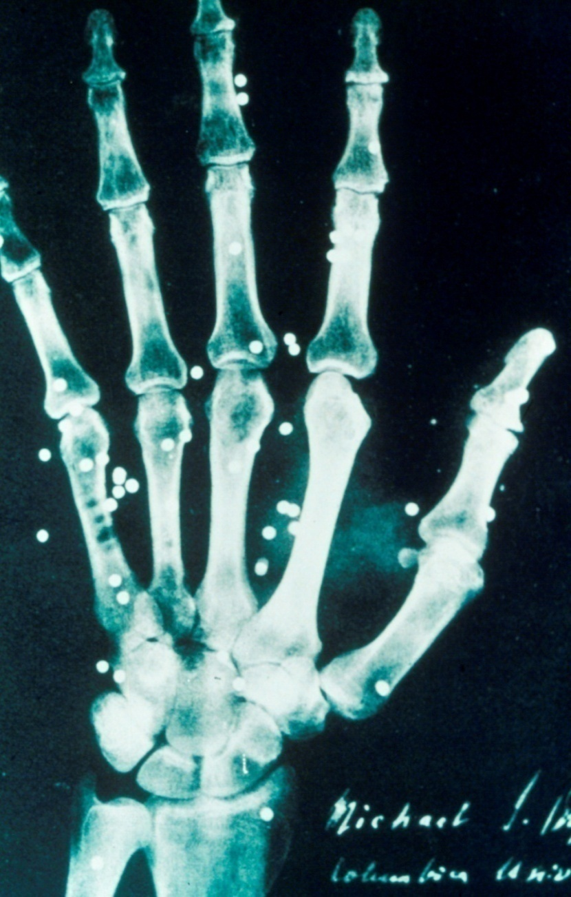

Slide 66
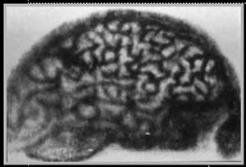

Slide 67
What Universities do
Teaching - for 800 years
Research - for 170 years
Knowledge Transfer - for 25 years
Impact - for 10 years

Slide 68
Impact – General
Impact can take a long time to become apparent
Impact is not static – it continues to change with time
Impact is not always positive – also it can move from positive to negative
The narrative and presentation of impact has become an industry and may distort actual impact

Slide 69
Impact – Measurement
Measurement of impact needs to be prospective not retrospective
Parameters of impact should be determined prospectively to enable measurement and the creation of evidence
Impact needs to be evidenced, often quantitatively - this may require some cultural adjustment in some academic areas
Impact requires external independent validation - this often needs to be sought out

Slide 70
Impact – Resource Implications
The measurement of impact is time consuming
The accurate measurement of impact is expensive
Funding is generally not available to demonstrate or measure impact - if it is, too much is expected for too little funding
The production of evidence to demonstrate impact needs funding to find it and measure it properly
Everyone thinks its everyone else’s responsibility to fund the cost of impact assessment

Slide 71
Impact - Planning
Choose research problems that a priori you expect to have an impact - potential impact could influence an early research strategy
Impact should be part of the plan

Slide 72

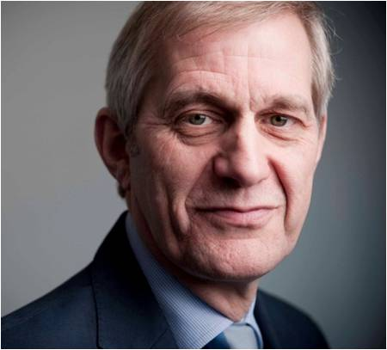
Contact details:
Professor Mike Smith
Prof MASmith@gmail.com m.a.smith@harperkeeley.com
+44 (0)7785 736848 www.harperkeeley.com
Integrating societal impact in a research strategy
28 November – 30 November 2018, Leuven

